Slide 1
To – Do Website
By Mary Phelan – C00249325

Slide 2
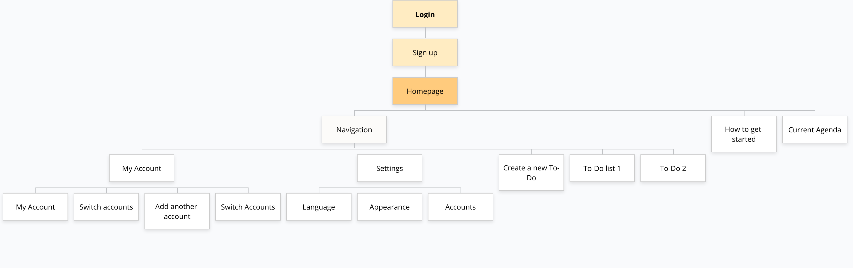
Site Map

Slide 3
Key
Logo
Content
Navigation

Slide 4
Desktop wireframes

Slide 5
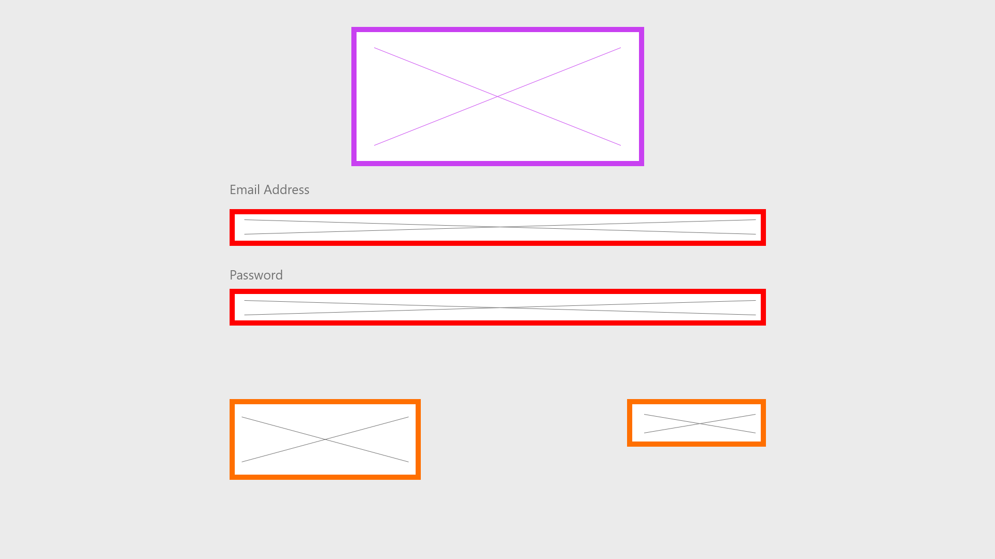
Login Page
Keep the logo centred on the page
User can log in using their designated email and password
Button that will enable the user to Login
A button/hyperlink which will allow the user to create an account if they don’t already have one

Slide 6
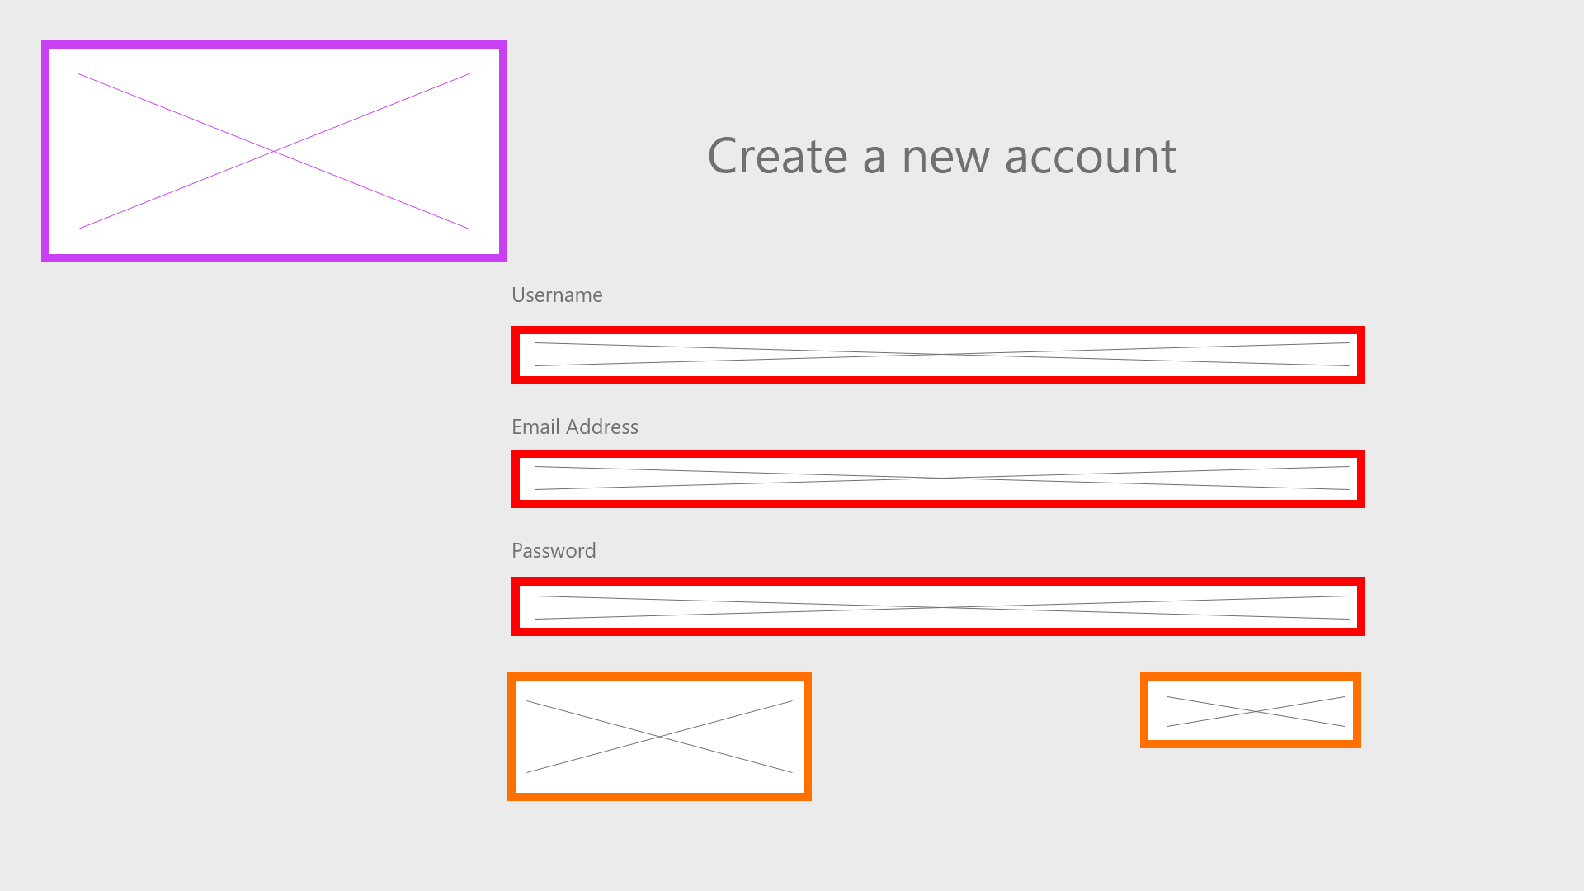
Account Creation Page
Title of page
Logo
Enter preferred username
Enter email address to link to account
Enter password for the account
A button/hyperlink which will bring the user back to the log in page, in case they already have a pre existing account
Sign up button

Slide 7
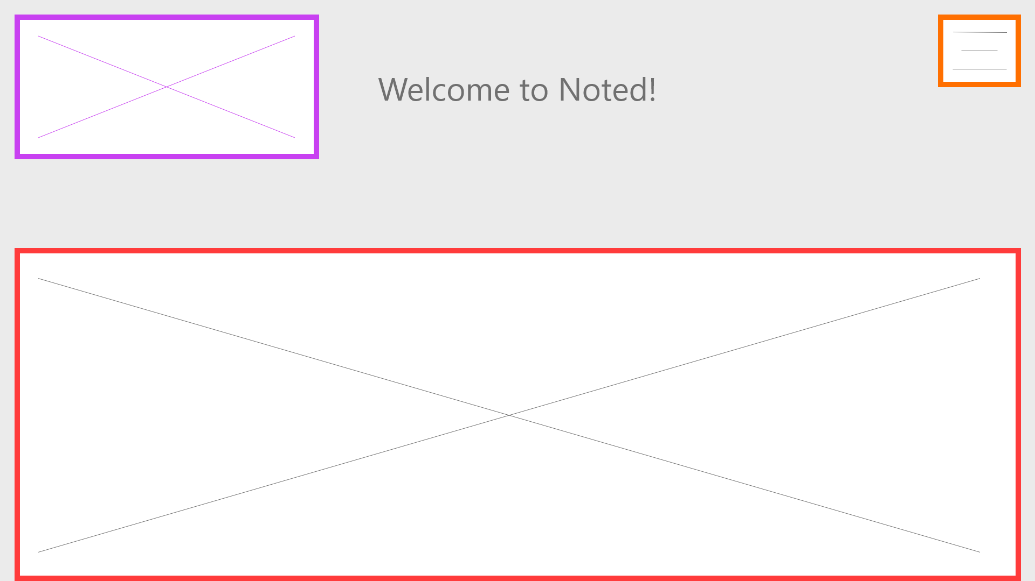
Welcome/How to get started page
Navigation button – will show the user different paths to go through the website
Page will contain a guide on how to navigate the website using the navigation button

Slide 8
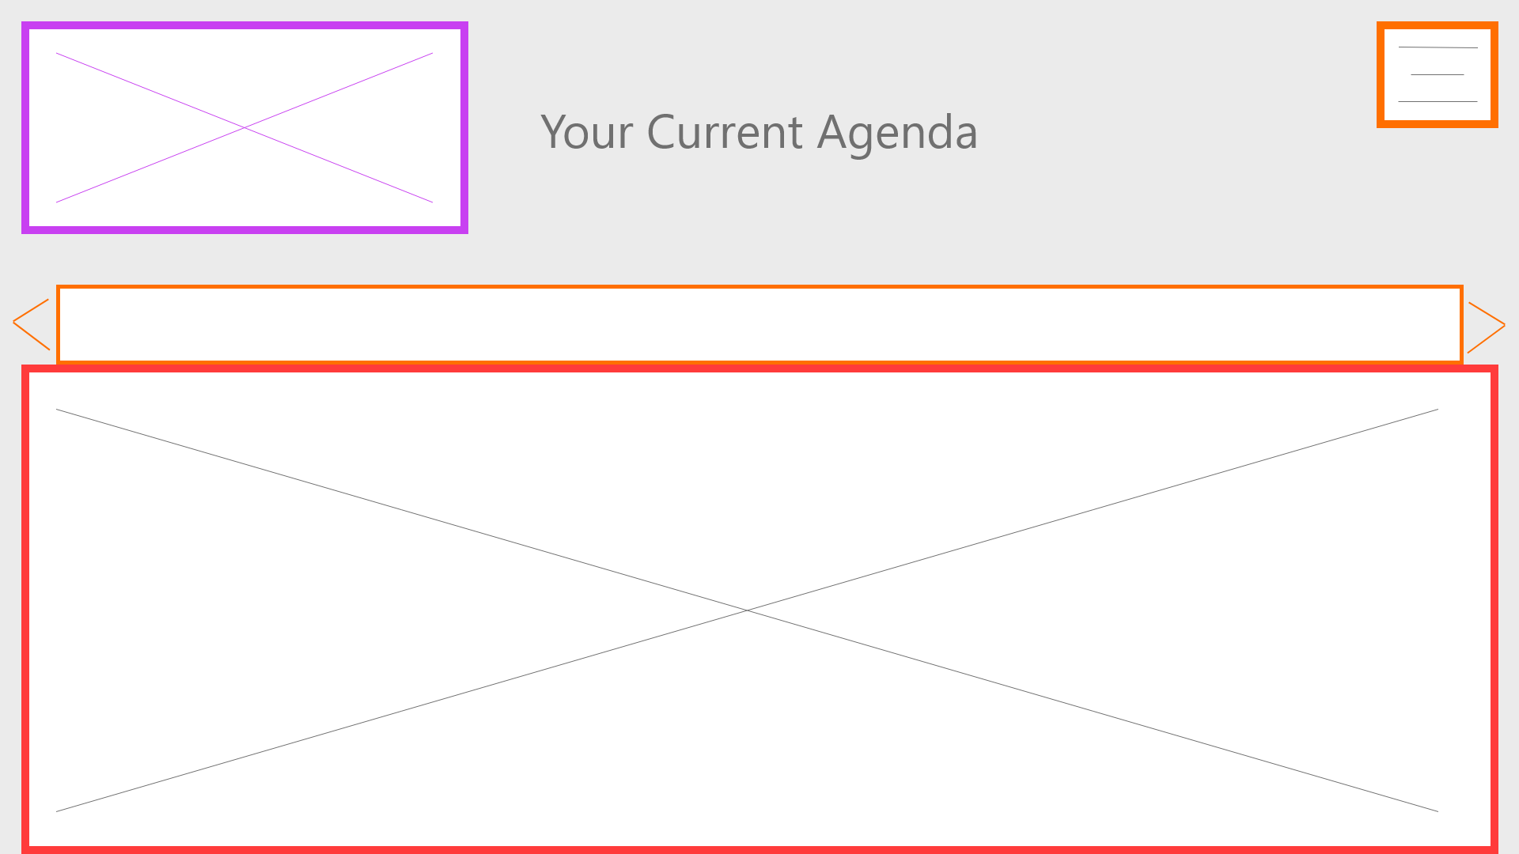
Agenda Page
This nav bar will allow the user to click through the months of the year using the arrows either side
This will show the days within that month chosen and also any tasks that were assigned to certain days
User can click on a certain day and see what task are coming up and can add more

Slide 9
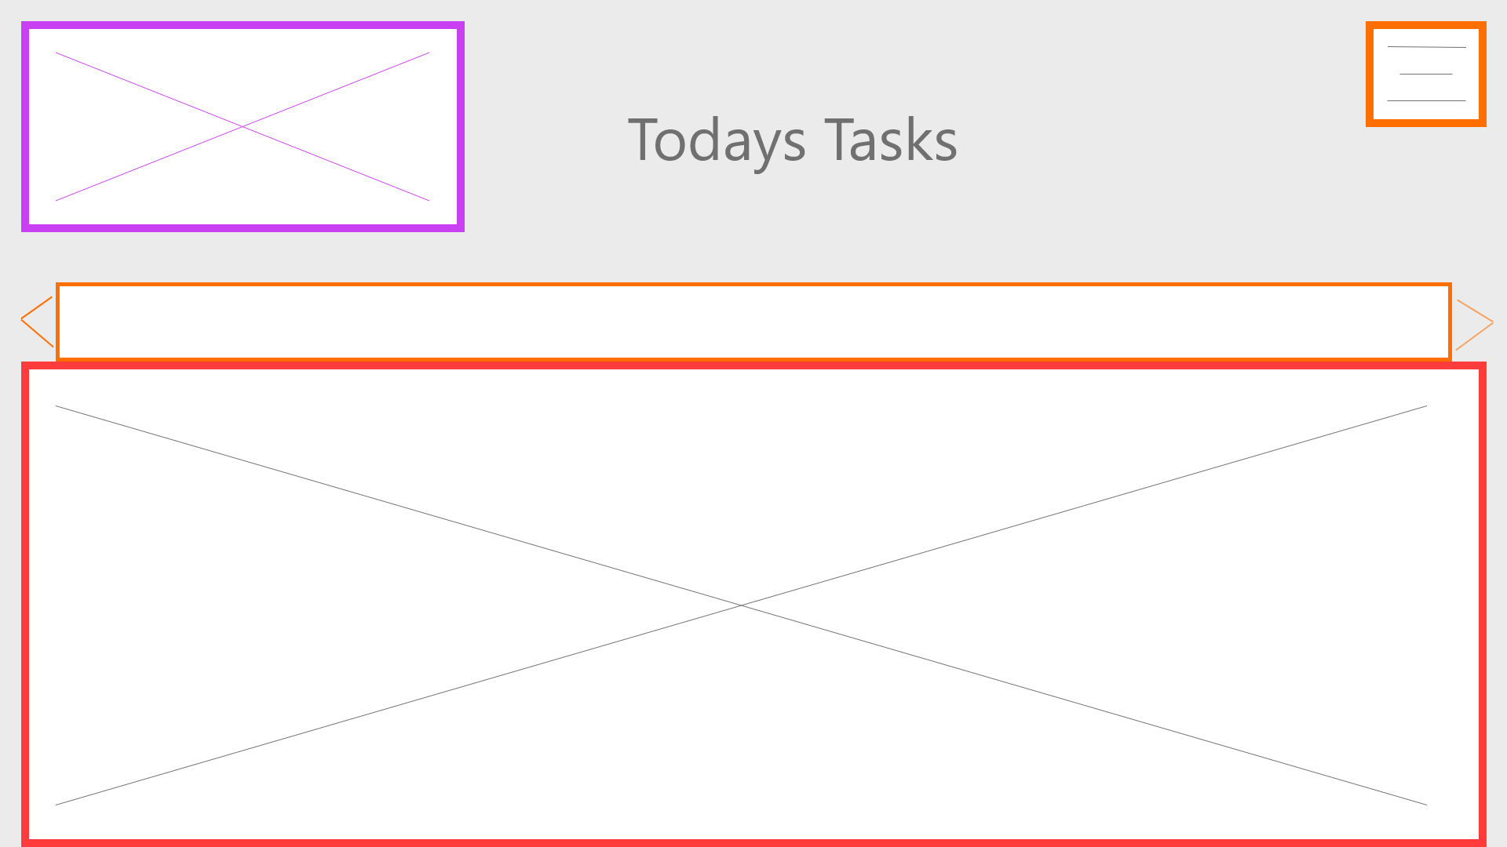
Task Page
Once the user clicks on a certain day, the day will fill up this box and will show any assigned tasks to that day and can add more or mark as done
Nav bar to click through the months

Slide 10
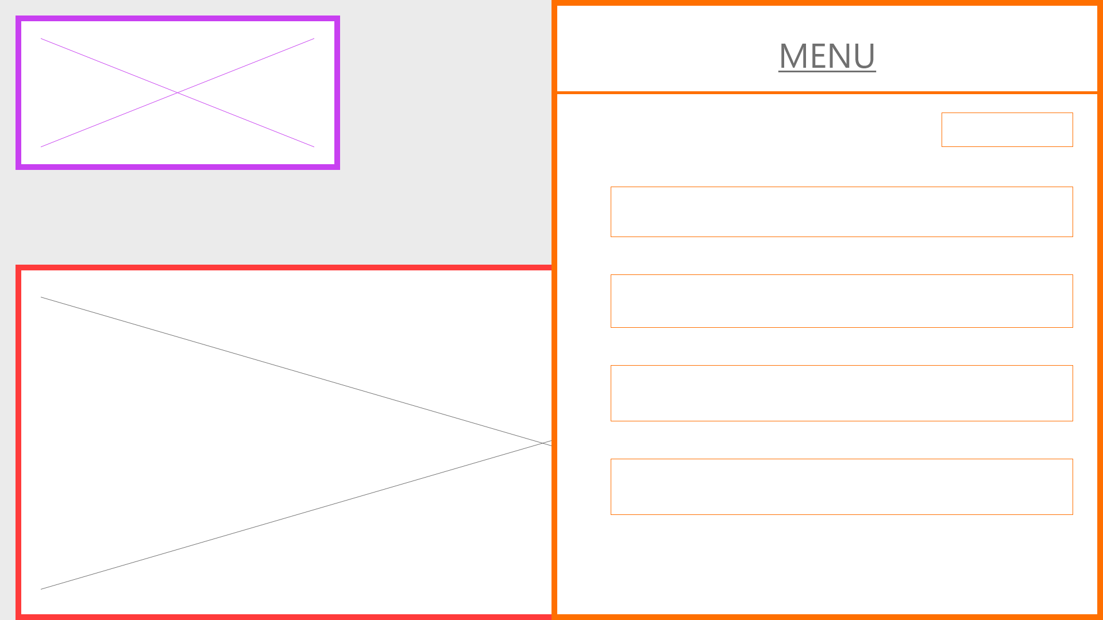
Navigation Menu
‘My Account’ – allows the user to edit their profile/ switch accounts
Navigation menu will slide half way across the users screen when clicked
A selection of options will come up for the user to click on

Slide 11
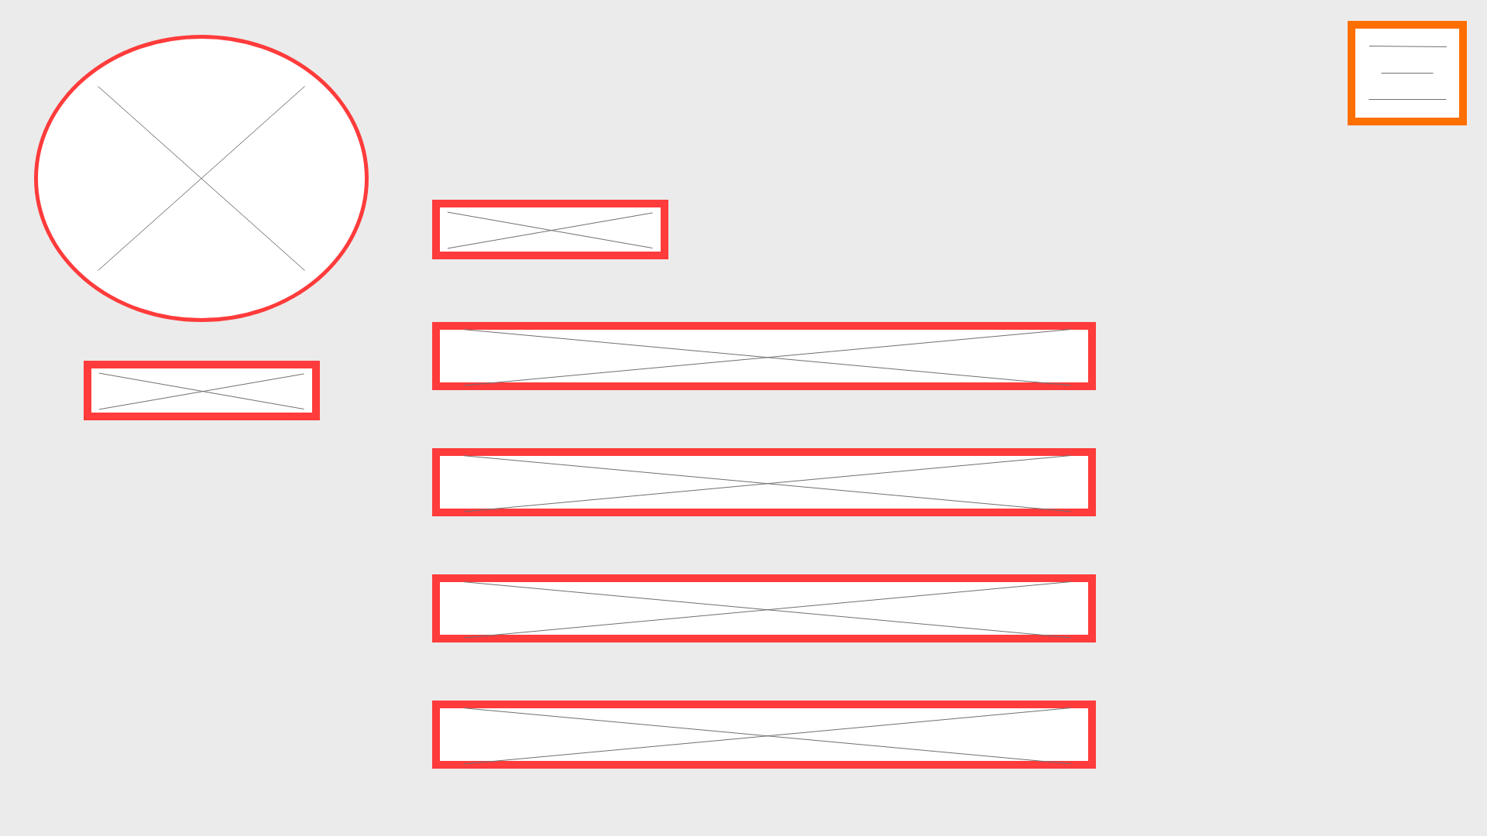
‘My Account’
Option to switch accounts – will bring user back to login page
Users chosen profile picture will appear here
Option to change profile picture
Users Name
Option to add a new account – will bring user to the Account Creation page
Option to change email address associated with the account
Option to change password associated with the account

Slide 12
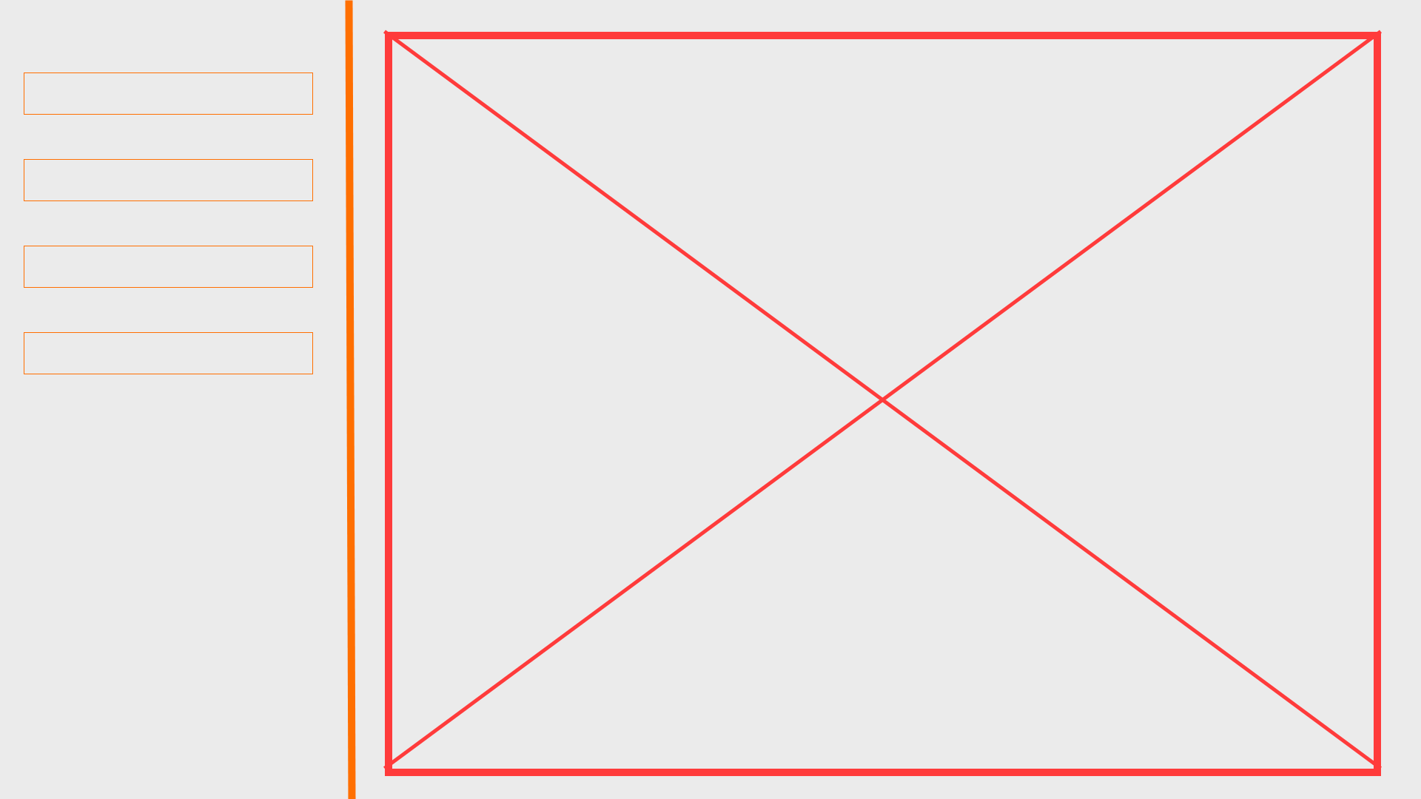
Settings
A selection of options for the user d to choose from such as ‘Appearance’ and ‘Language’
Chosen settings option will appear here
Sidebar will remain static even when an option is chosen, as shown

Slide 13
Mobile wireframes

Slide 14
Key
Logo
Content
Navigation

Slide 15
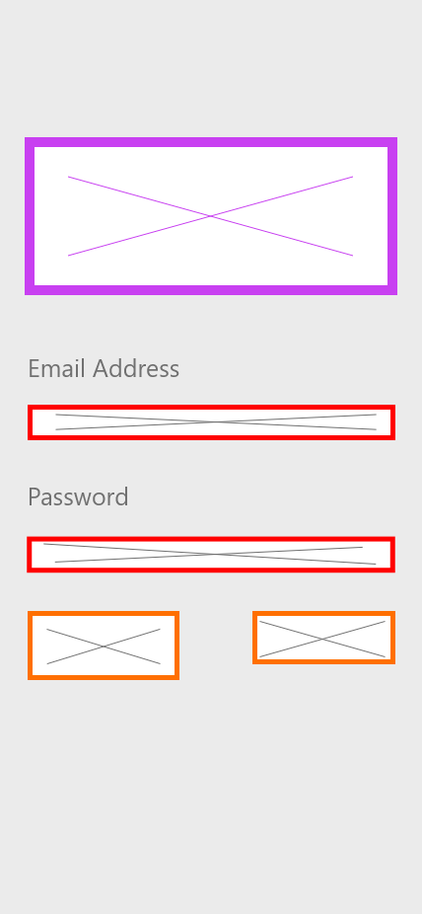
Login Page
Kept the same layout, resized to fit the screen better and look more pleasing to the eye

Slide 16
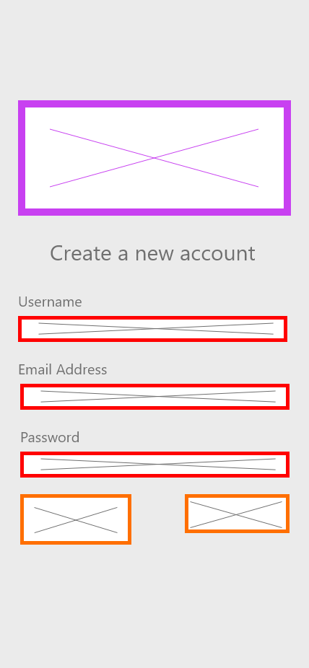
Account Creation Page
Kept the same layout, resized to fit the screen better and look more pleasing to the eye, similar to the login page

Slide 17

Welcome/getting started Page
Kept the same layout as the desktop and fit it to mobile

Slide 18
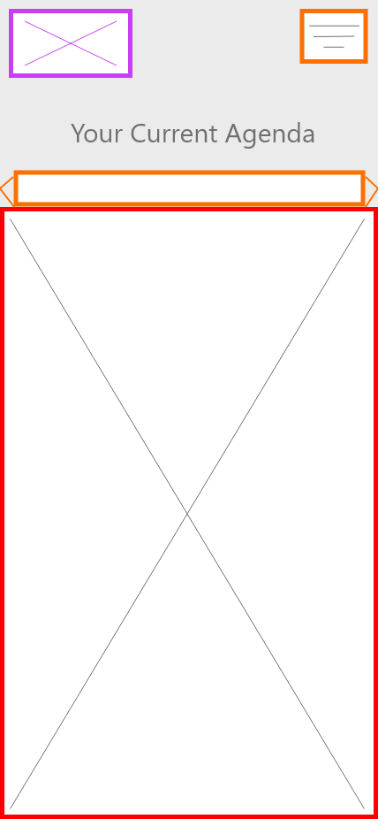
Agenda Page
Kept the same layout as the desktop and fit it to mobile

Slide 19
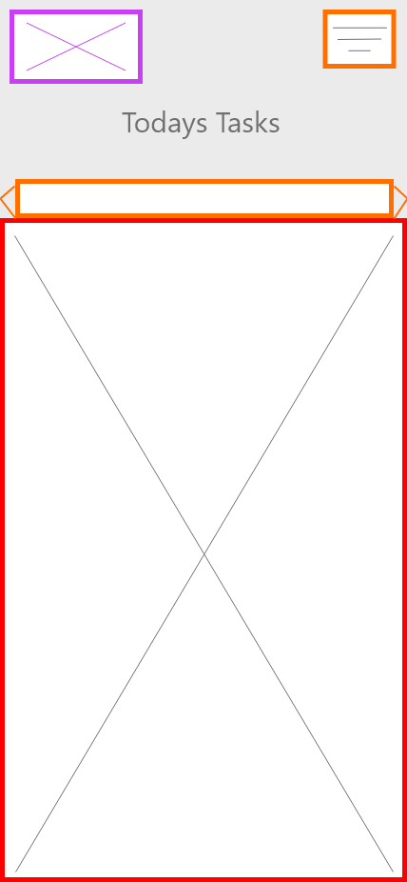
Task Page
Kept the same layout as the desktop and fit it to mobile

Slide 20
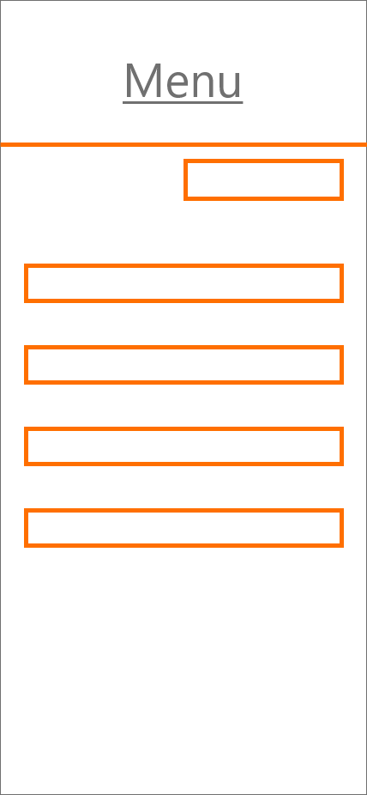
Navigation Menu
Instead of going halfway across the screen like the desktop, the navigation will take up the whole screen

Slide 21
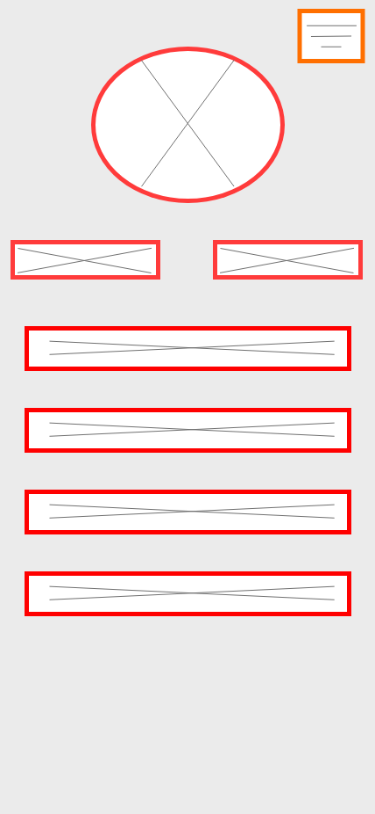
‘My Account’
All of the options have been moved under the profile picture, with the navigation menu staying in the top right.

Slide 22
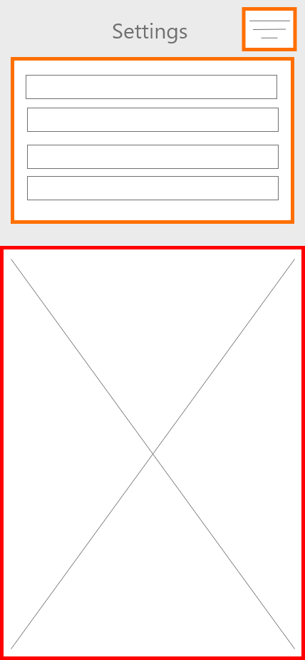
Settings
The settings options have been moved to the top of the screen and the option selected opens up below them.

Slide 23
Desktop Prototype

Slide 24
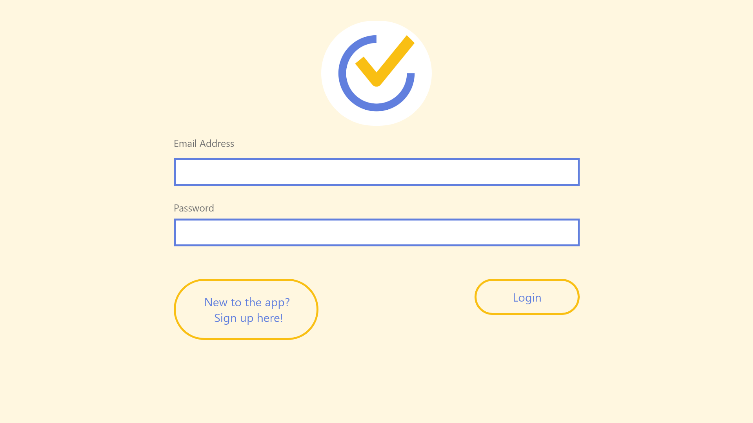
Login Page
Chose a warm yellow tone for the background, as it is gentle on the eye
Made the input box outlines the same colour blue as in the logo
Rounded the edges of the hyperlink buttons and made there outlines the same colour orange as in the logo
Also made the font the same colour blue to make them stand out as buttons

Slide 25
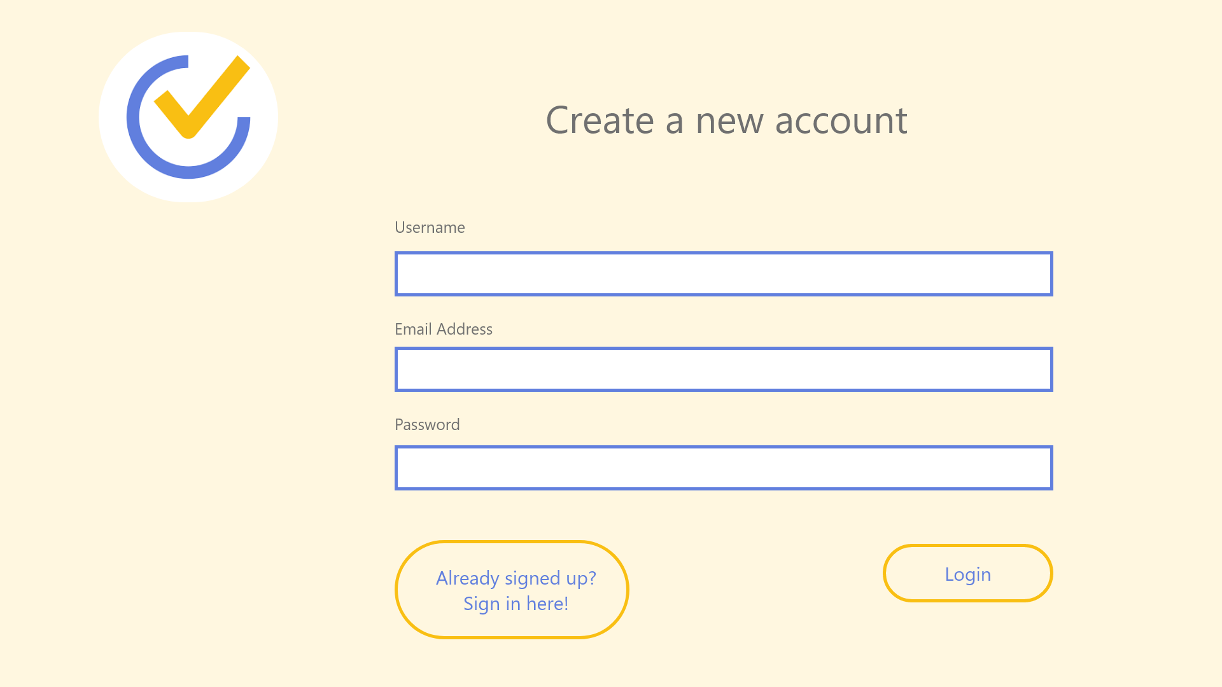
Account Creation Page
Kept same them as before, blue and orange outlines and rounded edges

Slide 26
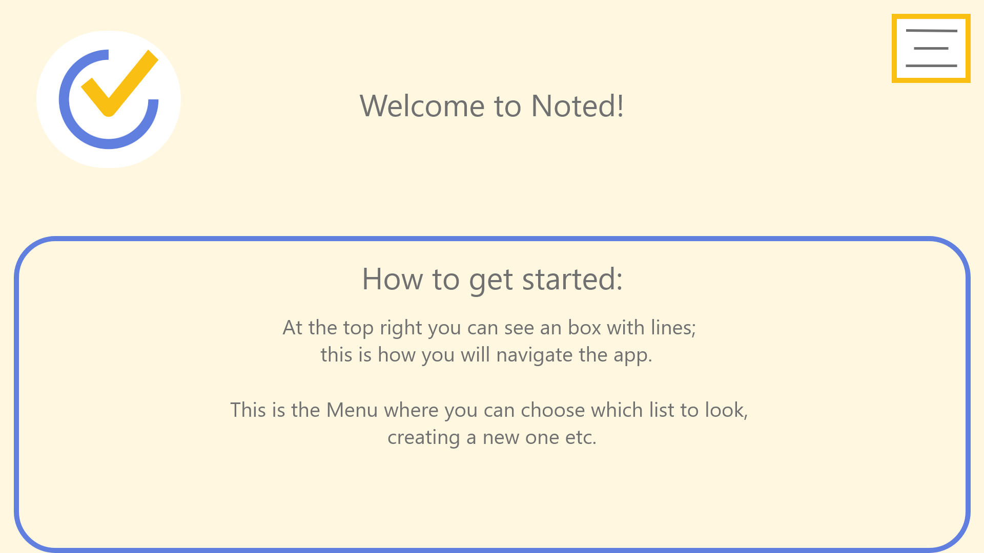
Welcome/getting started Page
Made the navigation outline the same orange as the logo and made the lines inside thicker to stand out more
Font is a medium/light grey, to sit nicely on top of the yellow – user is given a guide for the website
Made the outline blue and rounded the edges

Slide 27
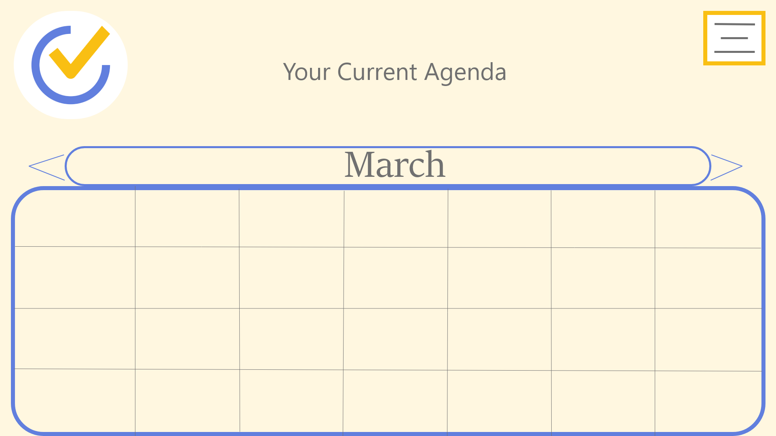
Agenda Page
Calendar will show all the days in the current month slected

Slide 28
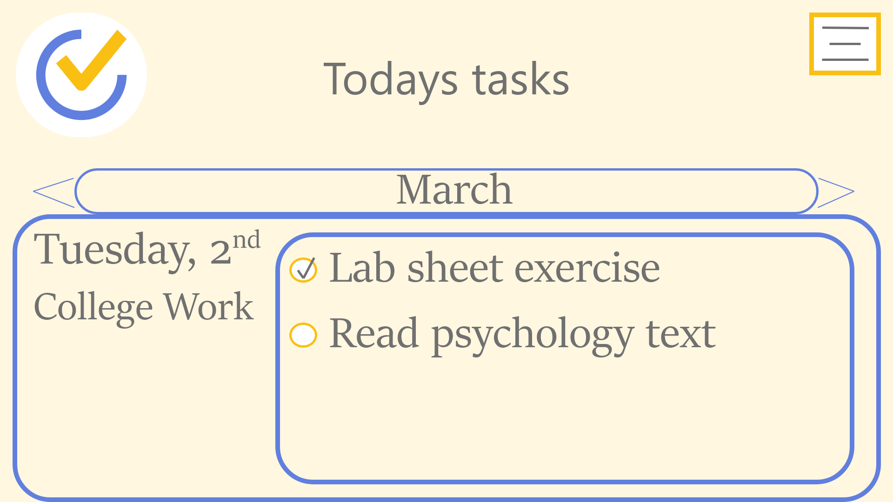
Tasks Page
User can see their current tasks for the day they select and can mark it as done by clicking on the circle icon
Current date selected and title of what list is appearing on that day

Slide 29
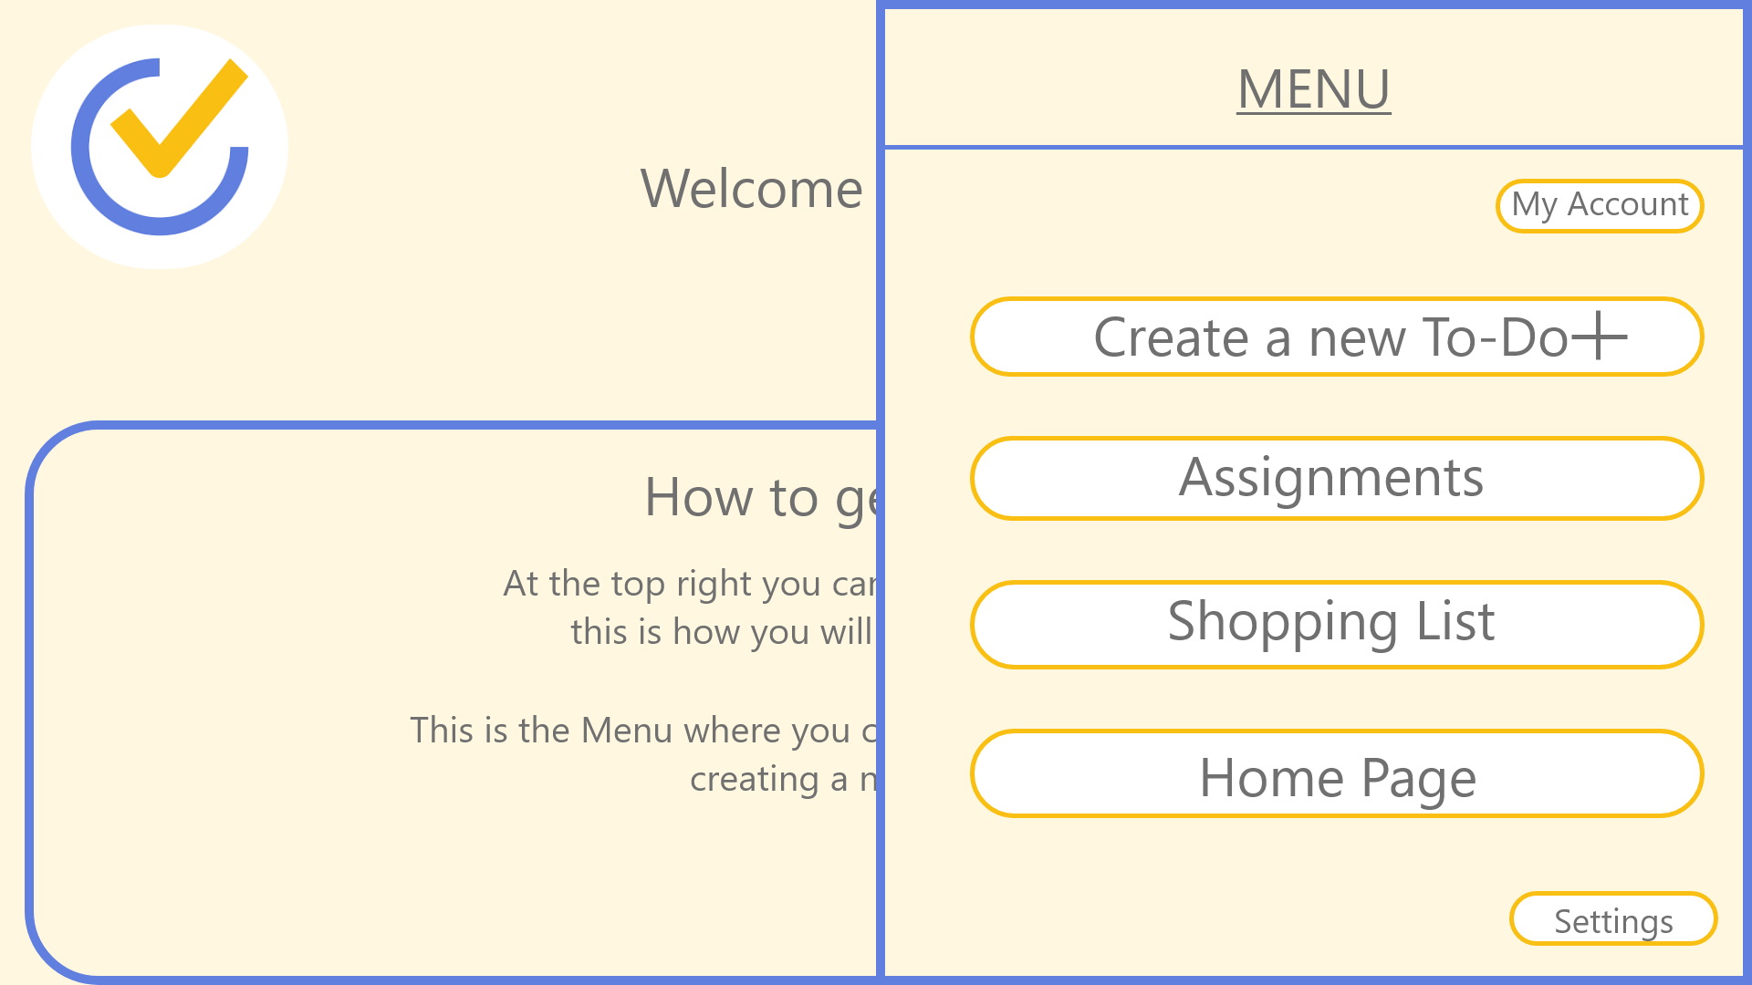
Navigation Menu
Made the navigations outline same blue colour when opened
Made the options outlines the same orange and rounded their edges

Slide 30
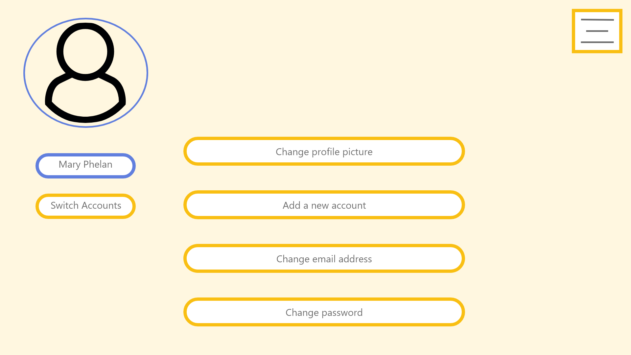
‘My Account’
Rounded the edges of all the options and made the clickable options orange but left the name box outline blue

Slide 31
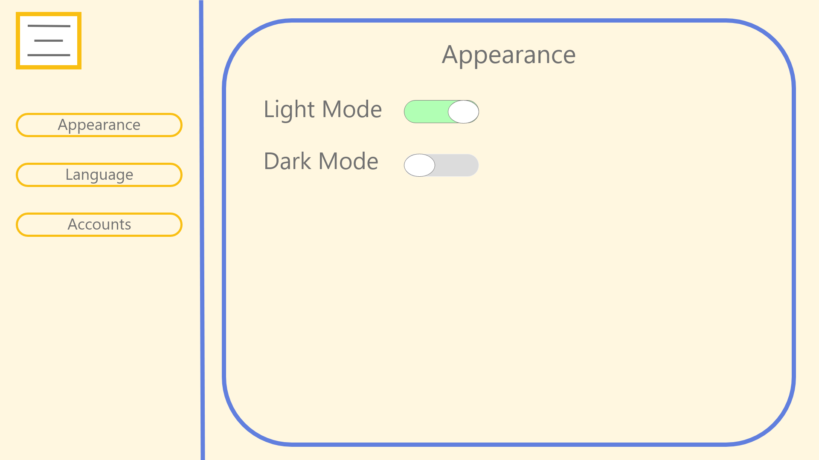
Settings Page
Rounded the edges of the page and made its outline blue.
Rounded the edges and made them orange
Made the switch turn green when activated and grey when inactive

Slide 32
Mobile Prototype

Slide 33
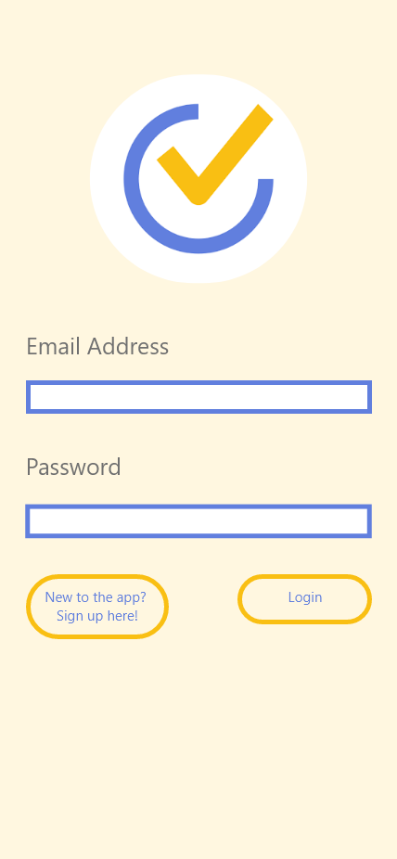
Login Page
Kept the same theme for the mobile version throughout the website

Slide 34
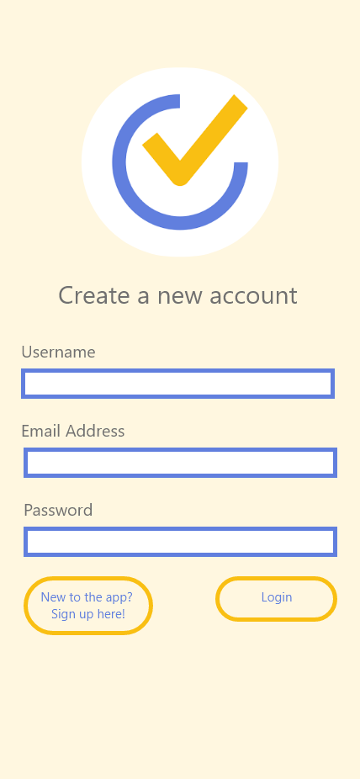
Account Creation Page

Slide 35
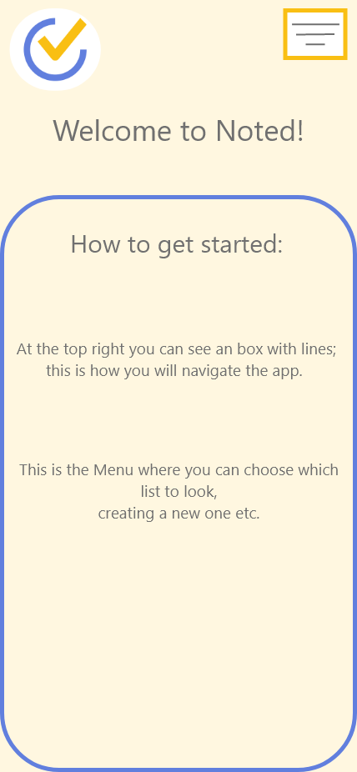
Welcome/getting started Page

